Slide 1
Apple, Inc.

Slide 2

Think Different !

Slide 3
Company Profile : Apple Inc.
Industry of : Computer hardware and software
Consumer electronics
Founded in : April 1, 1976.
Founded by : Steve Jobs , Steve Wozniak , Ronald Wayne.
Headquarters at : Cupertino, California (CA,USA)
Area served : Worldwide
Current CEO : Tim Cook (USA)
Boards Chairman: Arthur D. Levinson (CEO of Oracle)
Net Revenue : US$ 358.98 billion [August,2014]
Employees : 98,000 (2014) were [42,800 are Indian Employees]

Slide 4
INTRODUCTION :
Apple Inc. is an American multinational corporation Company which designs, develops, and sells consumer electronics, computer software's, online services, and personal computers.
Apple is the world's second-largest information technology company by revenue after Samsung Electronics.
And World's third-largest mobile phone maker after Samsung and Nokia.
After breaking record of Ford Motor Company it sated record of Highest capital stock income in stock history.

Slide 5
VISION :
“ Man is creator of change in this world. As such he should be above system and structure and not subordinate to them. “
MISSION :
Apple committed to bringing the best personal computing experience to students , educator , creative professional and consumers around the world through its innovative software's,hardware’s and internet offering .

Slide 6
SWOT ANALYSIS :
Strength : Well recognized, Good planning, Product differential unique design, Brands,Finantial performance ,Global mobile phone market.
Weaknesses : Defects may harm reputation and significant warranty, Patent infringement lawsuit.
Opportunities : Strong growth in Smartphone's, Strong robust outlook, Increasing demand online music .
Threats : Rising popularity of Google’s Androids, Steve Jobs Death, Highly depend on consumer.

Slide 7
HISTORY :
Apple was founded by Steve Jobs, Steve Wozniak, and Ronald Wayne on April 1, 1976, to develop and sell personal computer kit name Apple-I which was made by Steve Wozniak and maintain by Steve Jobs.
In 1985, John Sculley, CEO of PEPSICO Became next CEO of Apple
After Jobs got fired from company , Apple’s first ‘portable Macintosh computer’, released in 1989.

Slide 8
HISTORY :
In July 1997, Jobs return in company and acted as the interim CEO [iCEO] and began restructuring the company's product line.
On August 24, 2011, Jobs resigned his position as CEO of Apple.
He was replaced by Tim Cook and Jobs became Apple's chairman.
And after death of Steve Jobs in October 2011 until now, Tim Cook working as CEO of Apple Inc.

Slide 9
MANAGEMENT :
Founder : Steve Jobs, Steve Wozniak , Ronald Wayne.
Current C E O : Tim Cook
Director on Board : Arthur D. Levinson
Deputy President : Angela Ahrendts (Online stores)
Deputy President : Jonathan Ive (Design)
Deputy President : Craig Federighi (Software Engineering )
Total Locations : 427 retail Stores in 17 Countries (August 2014)
Services to be serves : Apple Store, iTunes Store, iBook's, iCloud ,etc.

Slide 10
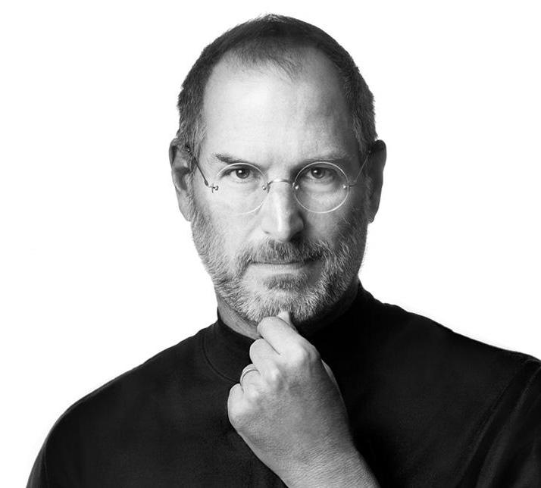
Steve Jobs
Founder,Apple Inc.

Slide 11
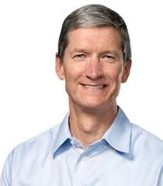
Tim Cook,
CEO, Apple Inc.

Slide 12
PRODUCT HISTORY :
In April 16, 1977 , The Apple-II was invented by Steve Wozniak and maintain by Steve Jobs.
It had colour graphics and an open source architecture.
Apple-II gave relativity to home users and offices with the use of Microsoft office 1.0 .

Slide 13
PRODUCT HISTORY :
After Apple-II, Jobs brought patent of Graphical User Interface from Xerox.
And In 1983, they founded LISA.
LISA was first personal computer which sold to the public with a GUI (Graphical User Interface)
After LISA, Apple founded Macintosh.
Macintosh was the first personal computer to be sold without a programming language at all.

Slide 14
PRODUCT HISTORY :
In 2007, Jobs introduced iPhone.
It was largest selling Smartphone before launchings Google’s Android.
After Success of iPhone-4, iPhone-4s , iPhone-5,5S and 5C Apple launched its new brand Apple iPhone-6 on 9 September 2014.

Slide 15
CARIER AT APPLE :
In Engineering :
as Software,Hardware,Researcher,Designer,etc.
In Commerce :
as Accountant,etc.

Slide 16
CARIER IN INDIA :
Excellent highly qualified People required at apple’s Indian headquarter Mumbai, Delhi and Bangalore.

Slide 17
Conclusion :
Apple Inc. have more employment capability and flexibility than any other Electronics Consumer Company. And apple gives chance to served Human Mankind with help of Current advanced technology.

Slide 18
REFERENCE’s:
Links :
1. http//www.apple.com/about/apple 2. http//www.wikipedia.com/applecomputer
Others :
Steve Jobs : By Walter Isaacson (Book)
Britannica Encyclopedia

Slide 19
Associate Professor:
Prof. Churchill Samson
Presented By :
Priyanka Gaikwad
Sonali Oswal
Kartik Patil
Harshad Shinde
Yadnyawalkya Tale

Slide 20
THANK YOU !

